Slide 1
The Excellent Properties of a Dense Grid-Based HOG Feature on Face Recognition Compared to Gabor and LBP
-Zheng Xiang

Slide 2
INTRODUCTION
Biometrics was introduced at the end of the nineteenth century, and its real development was in the twentieth century. After the 1990s, it entered a period of rapid development. There have been many classic algorithms, such as Eigen- faces , Fisher-faces , EBGM and so on. Later, after the year 2000, due to the emergence of a large number of face databases (such as CAS-PEAL and FERET ), researchers were forced to detect whether their algorithms were effective or not so that the face recognition algorithm achieved a very high recognition effect in the ideal case.
Detecting a specified object in a given image is a difficult task due to its possible widely variable appearance. An essential requirement for this task is a robust feature set that allows the appearance of the object in the image to be discriminated cleanly, even in complex backgrounds under all possible illumination effects. Study of the existing literature shows that Histogram Oriented Gradient(HOG) feature is one of the most powerful feature for object recognition in scene images.

Slide 3
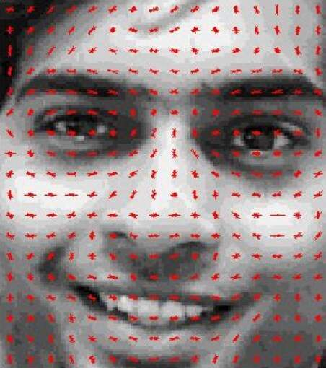
Histogram of Gradients
A HOG is a feature descriptor generally used for object detection. HOGs are widely known for their use in pedestrian detection. A HOG relies on the property of objects within an image to possess the distribution of intensity gradients or edge directions. Gradients are calculated within an image per block. A block is considered as a pixel grid in which gradients are constituted from the magnitude and direction of change in the intensities of the pixel within the block.

Slide 4
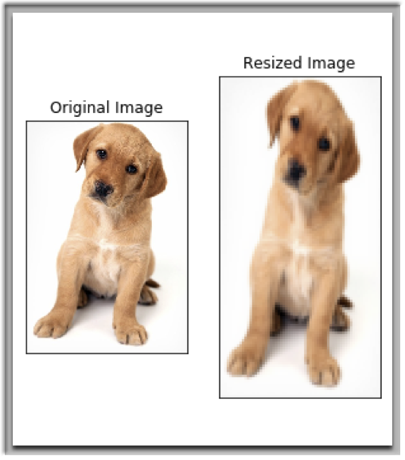
Methodology
STEP 1
Preprocess the Data (64 x 128)
Preprocessing data is a crucial step in any machine learning project and that’s no different when working with images.
We need to preprocess the image and bring down the width to height ratio to 1:2. The image size should preferably be 64 x 128.

Slide 5
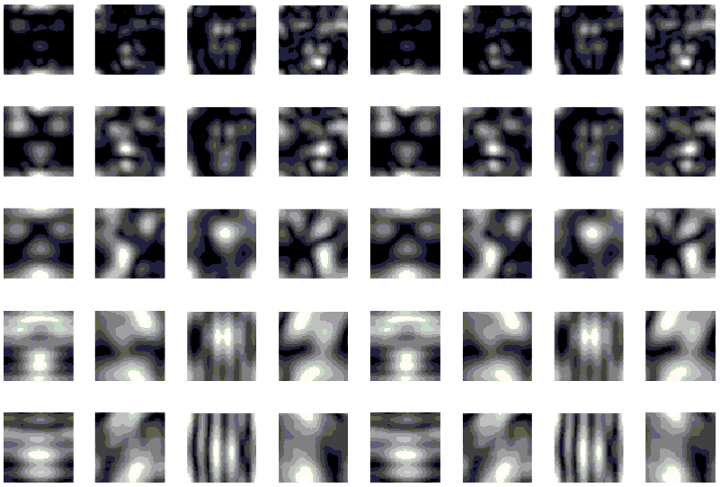
STEP 2
Calculating Gradients (direction x and y)
The next step is to calculate the gradient for every pixel in the image. Gradients are the small change in the x and y directions.
This process will give us two new matrices – one storing gradients in the x-direction and the other storing gradients in the y direction. This is similar to using a Sobel Kernel of size 1. The magnitude would be higher when there is a sharp change in intensity, such as around the edges.
• Change in X direction(Gx) = 89 – 78 = 11
• Change in Y direction(Gy) = 68 – 56 = 8

Slide 6
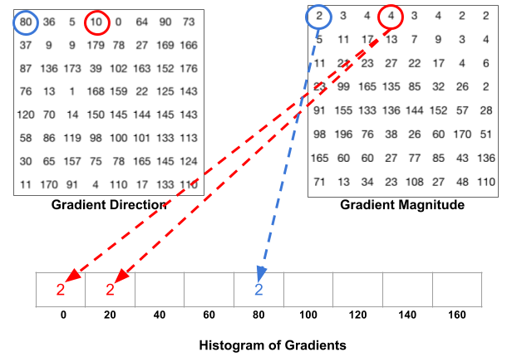
STEP 3 :
Calculate the Magnitude and Orientation
Using the gradients we calculated in the last step, we will now determine the magnitude and direction for each pixel value. For this step, we will be using the Pythagoras theorem
Total Gradient Magnitude = √[(Gx)2+(Gy)2]
Total Gradient Magnitude = √[(11)2+(8)2] = 13.6
Next, calculate the orientation (or direction) for the same pixel. We know that we can write the tan for the angles:tan(Φ) = Gy / Gx
Hence, the value of the angle would be:
Φ = atan(Gy / Gx)
The orientation comes out to be 36 when we plug in the values. So now, for every pixel value, we have the total gradient (magnitude) and the orientation (direction). We need to generate the histogram using these gradients and orientations.

Slide 7
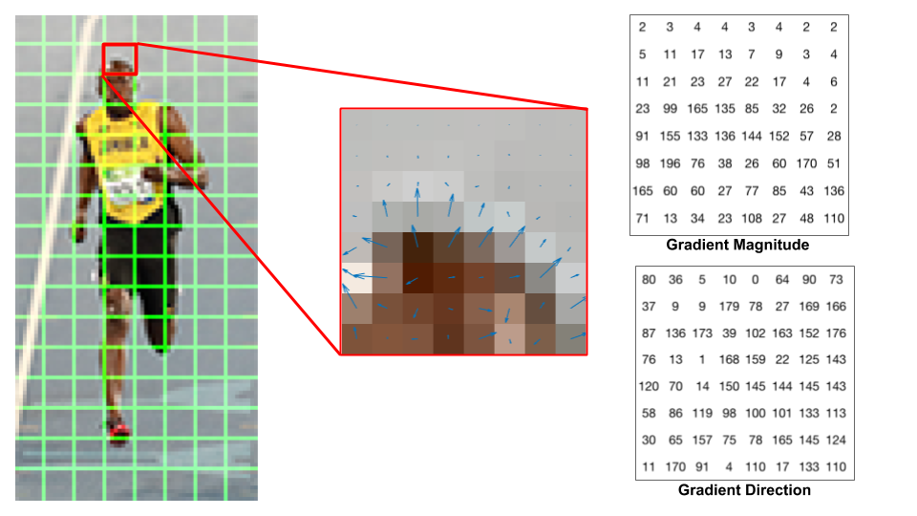
STEP 4 :
Calculate Histogram of Gradients in 8×8 cells (9×1)
The histograms created in the HOG feature descriptor are not generated for the whole image. Instead, the image is divided into 8×8 cells, and the histogram of oriented gradients is computed for each cell.
By doing so, we get the features (or histogram) for the smaller patches which in turn represent the whole image. We can certainly change this value here from 8 x 8 to 16 x 16 or 32 x 32.

Slide 8
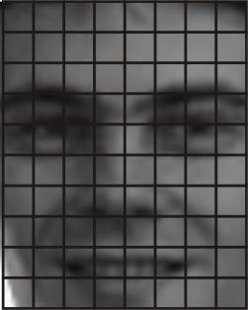
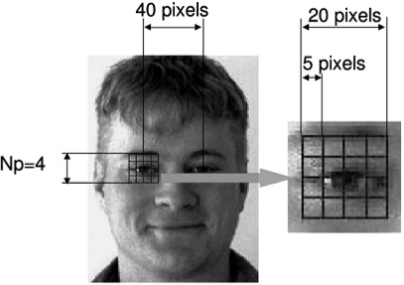
STEP 5
Normalise gradients in 16×16 cell (36×1)
Although we already have the HOG features created for the 8×8 cells of the image, the gradients of the image are sensitive to the overall lighting. This means that for a particular picture, some portion of the image would be very bright as compared to the other portions.
Here, we will be combining four 8×8 cells to create a 16×16 block. And we already know that each 8×8 cell has a 9×1 matrix for a histogram. So, we would have four 9×1 matrices or a single 36×1 matrix. To normalise this matrix, we will divide each of these values by the square root of the sum of squares of the values. Mathematically, for a given vector V:
V = [a1, a2, a3, ….a36] .We calculate the root of the sum of squares:
k = √(a1)2+ (a2)2+ (a3)2+ …. (a36)2
And divide all the values in the vector V with this value k: The resultant would be a normalized vector of size 36×1.
•Change in X direction(Gx) = 89 – 78 = 11
•Change in Y direction(Gy) = 68 – 56 = 8

Slide 9
STEP 6
Features for the complete image
We would first need to find out how many such 16×16 blocks would we get for a single 64×128 image:
We would have 105 (7×15) blocks of 16×16. Each of these 105 blocks has a vector of 36×1 as features. Hence, the total features for the image would be 105 x 36×1 = 3780 features.

Slide 10
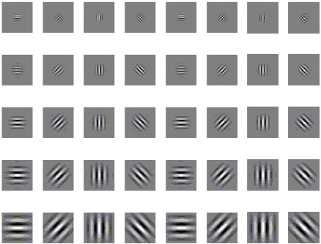
OVERVIEW OF THE GABOR WAVELET METHOD
The Gabor wavelet is one of the most popular feature description methods, and it is also one of the main- stream methods of facial descriptions. Gabor wavelets can well simulate mammalian visual neurone and capture salient visual features. A multi-resolution and multidirectional Gabor filter decomposition representation is obtained through the convolution of 40 Gabor kernels consisting of 5 scales and 8 directions. The result of the convolution consists of two parts, the real part and the imaginary part.

Slide 11
FACE RECOGNITION METHOD BASED ON GABOR
There are many methods of face recognition based on the Gabor.
They will extract the Gabor features of face images. Because the dimension of Gabor features is very high, the Gabor features will have 4 × 4 grid uniform sampling.
Then, the enhanced discriminant analysis (EFM) method is used to extract discriminant features and dimensionality reduction is concurrently realized.
Finally, the Euclidean distance or cosine distance is used to measure the similarity, and the k nearest neighbor classifier is used to recognize the human face.

Slide 12
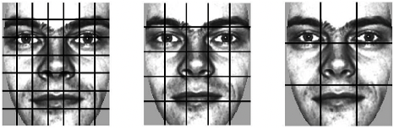
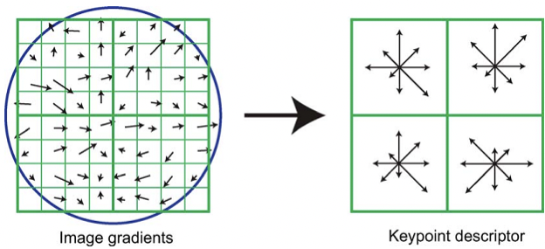
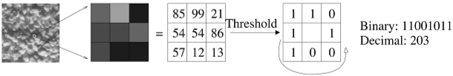
OVERVIEW OF THE LBP METHOD
The LBP of the local texture feature extraction method based on the local binary model is an effective non-parametric. method for local image texture descriptions. It uses the structure method to analyze the features of fixed windows and then uses the statistical method to extract the features. It is simple in calculation and can capture small detailed features in the image. It can also extract the local neighborhood relationship model that is more favorable for classification. The LBP has been successfully applied to many machine vision recognition tasks, including face recognition.

Slide 13
FACE RECOGNITION METHOD BASED ON LBP
In recent years, increasingly more face recognition methods have been proposed based on the LBP operator. These methods have shown that it is more important to preserve the information in the local space of the human face.
first, the LBP-based face recognition usually divides the human face into several regions. Then, the LBP features are extracted from each region window, and the LBP histogram of each region is computed.
Finally, the histogram of all regions is connected to the final human facial representation. The LBP operator produces a n = 2⁸ = 256 dimension histogram vector when P = 8. To reduce the dimensionality and generate robustness, the consistent pattern LBP^{u2} is used P,R
to represent the human face. The neighbourhood structure of P = 8 and R = 1 is often used. According to the definition of the consistent pattern, the histogram length of each region is n = 59 dimensions. When all regions are connected, the entire human face is represented. The face size is a n × m matrix. Finally, we can use different distance measures to obtain different facial feature vectors.
Since the face image is divided into several regions, the research shows that the face has different discriminative abilities in different regions. For example, eyes are more important than other parts in face recognition. Therefore, giving different weights to different regions in the facial area will lead to better recognition results.

Slide 14
FACE RECOGNITION METHOD BASED ON HOG ALGORITHM
The HOG feature descriptor comes from the last step of Lowe’s scale invariant feature transformation of the SIFT algorithm. However, because of its effective expressive power, it has received widespread attention and has become an important application is that it is used as a feature descriptor in pedestrian detection. The SIFT algorithm performs well in scene matching, objection detection, face recognition, and more. Because of its invariance to rotation and translation and scale scaling, it has a high tolerance to brightness changes, noise, view transformations and affine transformations. The SIFT algorithm steps are mainly divided into three parts:
(1) Scale space key point detection
(2)Assign orientation values to feature points(orientation assignment).
(3) SIFT feature descriptor(key point descriptor).
We analyse the third step of the SIFT algorithm, which is the feature description of the key points. Here, we use the HOG feature descriptor to describe a neighbourhood centred on the key point.

Slide 15
RESULTS:COMPARATIVE STUDY OF HOG AND LBP METHODS
For the data dimension analysis, the HOG uses fewer dimensions and achieves better recognition results than the LBP. At 80 × 64 resolution, the HOG algorithm is only 2560 dimensions, and the LBP algorithm in the paper [18] has 3304 dimensions. Since the block is small as 8 × 8, the dimensions will naturally be larger. However, even in such a large dimension, the overall recognition rate is not as good as our dense grid HOG.
The LBP and HOG feature extraction times are basically at the same level of magnitude. The LBP extraction time at 80 × 64 resolution is 9.0 ms, and the HOG extraction time at 80 × 64 resolution is 14.9 ms.
The recognition rate of our HOG algorithm has a significant advantage over the LBP algorithm.
Comparing to the best recognition obtained by the LBP at the 160 × 128 resolution rate, our HOG algorithm is only slightly inferior to the LBP algorithm in the fb test set. In the other test sets, its results were higher than those of the LBP algorithm, especially in the fc collection were the HOG algorithm is improved by 6.7%. We know that the fc test set is collected under different illuminations and camera equipment, and the dup1 and dup2 test sets were collected over time spans and changing environments.

Slide 16
RESULTS:COMPARATIVE STUDY OF HOG AND GABOR METHODS
The recognition rate of our HOG algorithm is slightly inferior to the Gabor-based GFC method.
Compared with the GFC algorithm, our HOG algorithm exceeded 12% in the dup2 test set, which shows that the HOG algorithm is more suitable for the changes in time and environmental conditions.
Furthermore, we also see that the GFC finally achieved good results when the dimension is reduced to 250 dimensions. This is because after linear discriminant analysis, by removing some redundant interference information, the GFC can obtain important discriminative information. Of course, there may be some discriminant information removed. However, the original dimension of the GFC was 163,840 dimensions, and after dimensional reduction there were 9,000 dimensions. These feature extraction steps must be considered, since a huge feature dimension will utilize a great deal of feature extraction time than the HOG.
The HOG extraction time at 80 × 64 resolution is 14.9 ms. Nevertheless, the Gabor feature extraction reached 258.2 ms at 64 × 64 resolution, which is 17.3 times greater than HOG. The greater resolution of the Gabor feature extraction consumes more computational time.

Slide 18
Implementation Details:
Generating HOG features on a single image in python.
The entire face recognition solution is divided into following major modules:
Face Capture
Face Train
Face Recognition
This will be done using concepts of OpenCV, face-recognition modules in python, dlib, Cmake, HAAR Cascade Classifier.

Slide 19
CONCLUSION
The HOG features are extracted based on non-overlapped dense grid face images, and the performances of face recognition under different parameters are analysed in detail. The performances are compared with the two popular local feature description methods of the Gabor and LBP. Experimental results show that the dense grid HOG feature can get a better recognition rate in relatively small dimensions, while the LBP features often need more feature dimensions to obtain similar recognition rates. More- over, the speed of the HOG feature extraction is basically the same as that of the LBP. In comparison with the Gabor features, the HOG and LBP features have not reached the high recognition rates of Gabor features since Gabor face recognition methods usually extract multi-scale and multidirectional dimensions, which can obtain more discriminant features. However, it requires a large number of dimensional features, which will require significant time to extract features from the images. The experimental results show that the Gabor feature extraction time is ten times greater than that of the dense grid HOG feature extraction.

Slide 20
-UTSAVI JITEN VISARIA 1911128
THANK YOU

